Slide 1
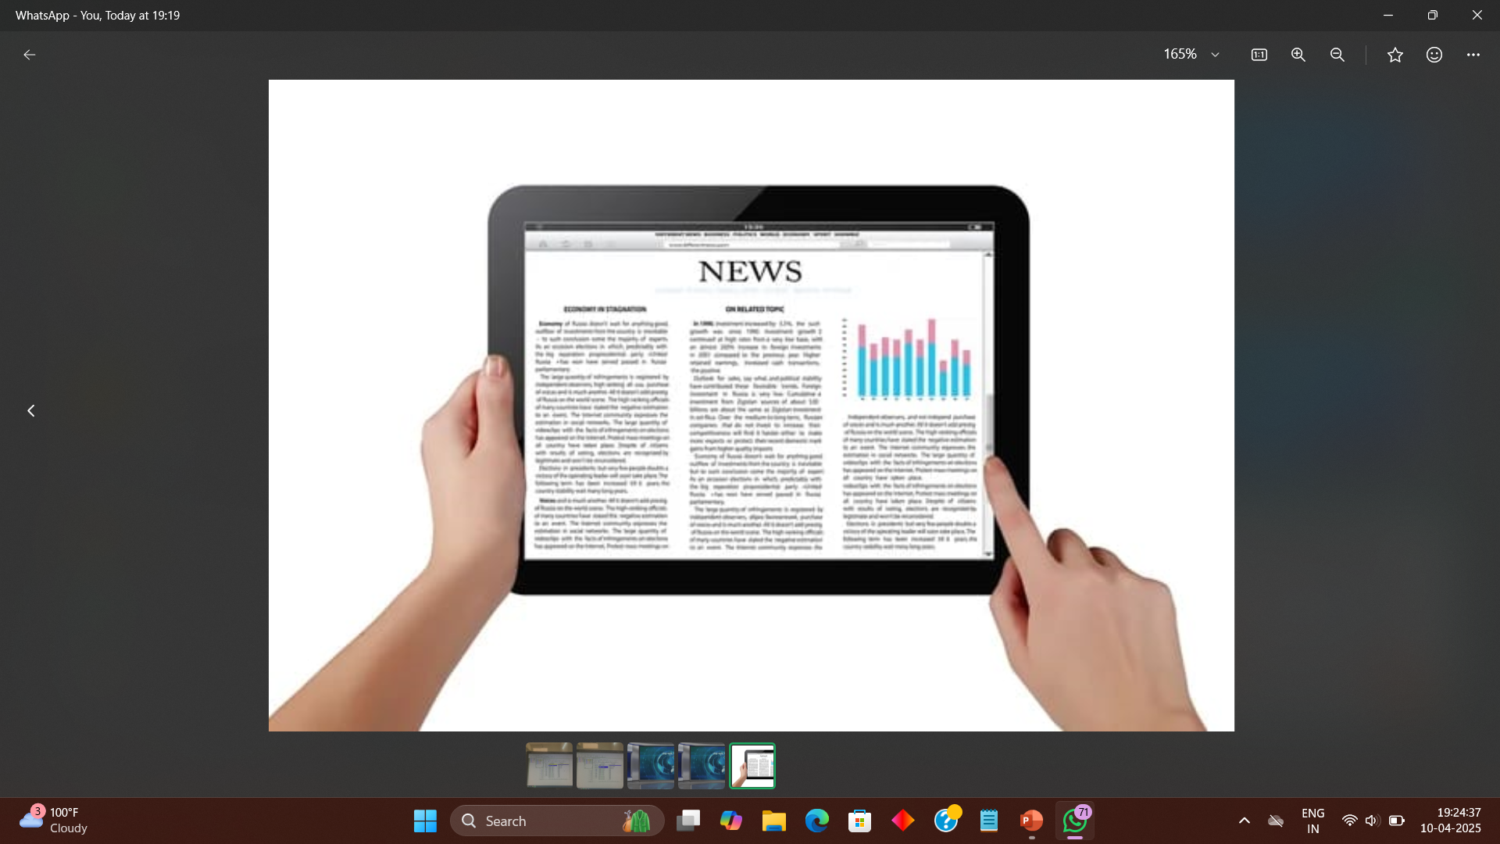
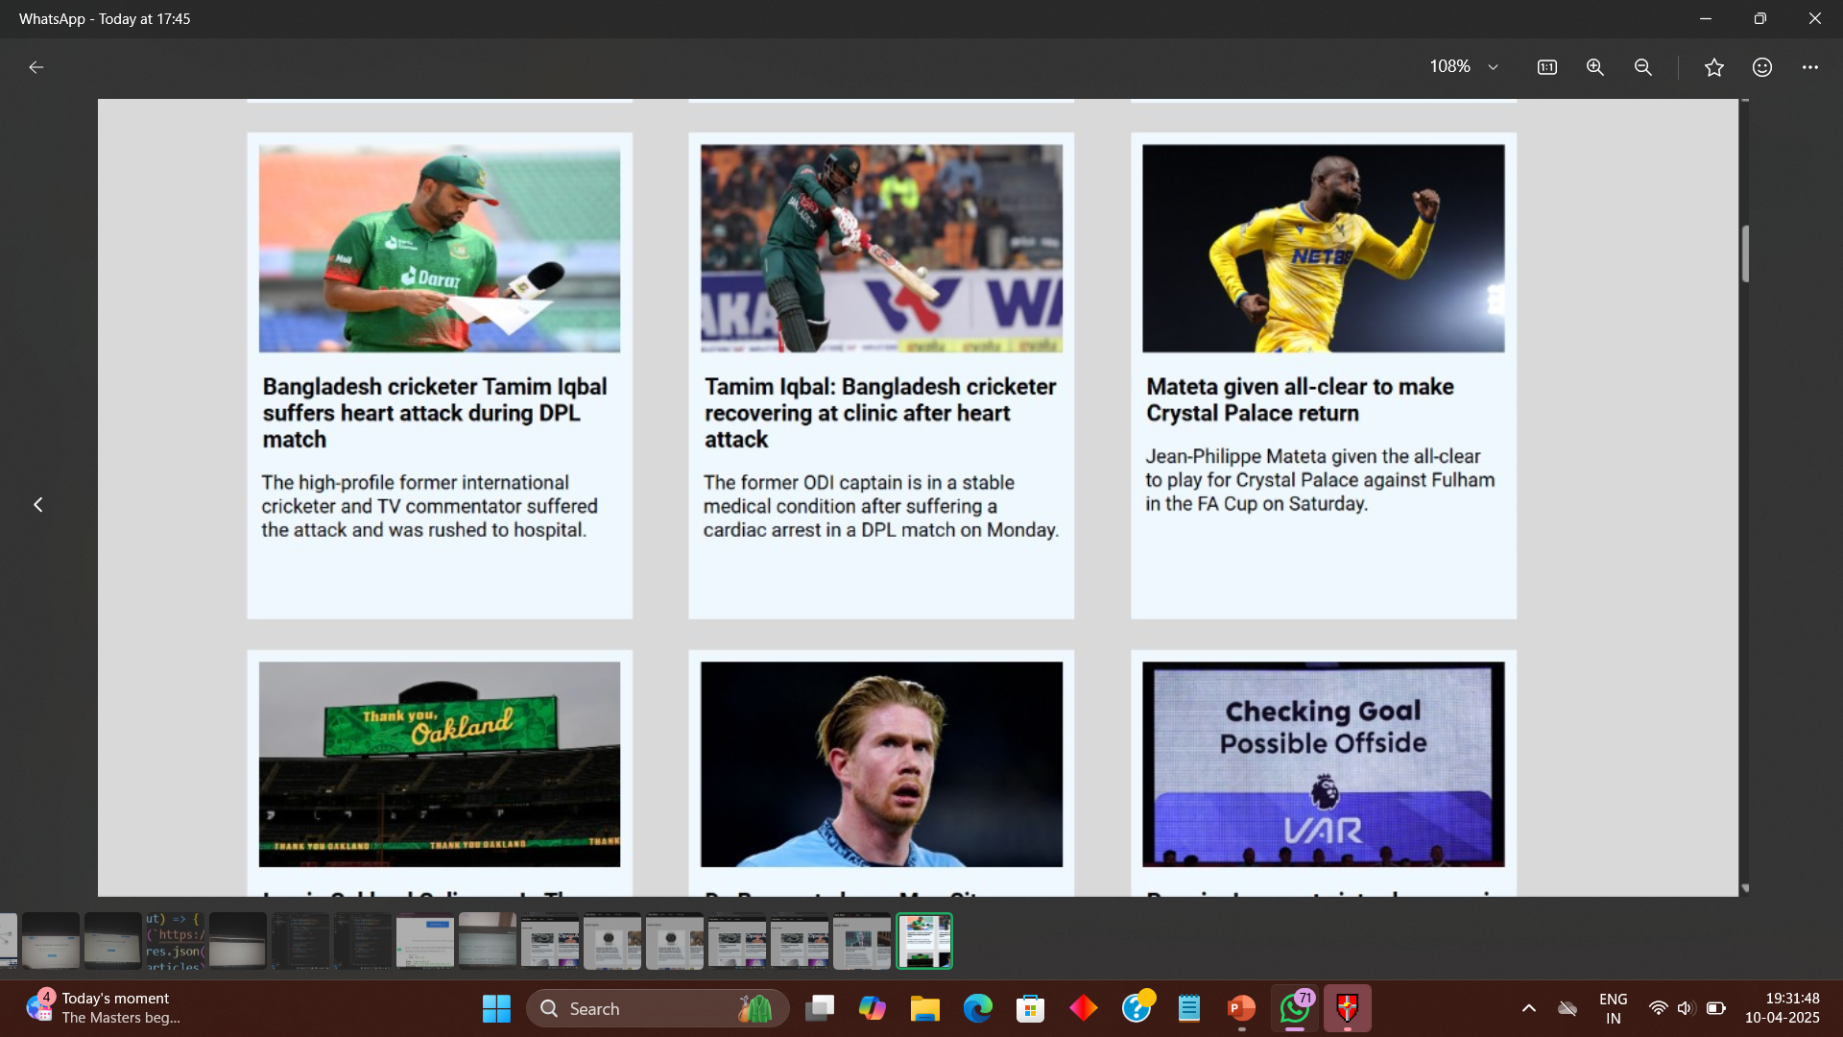
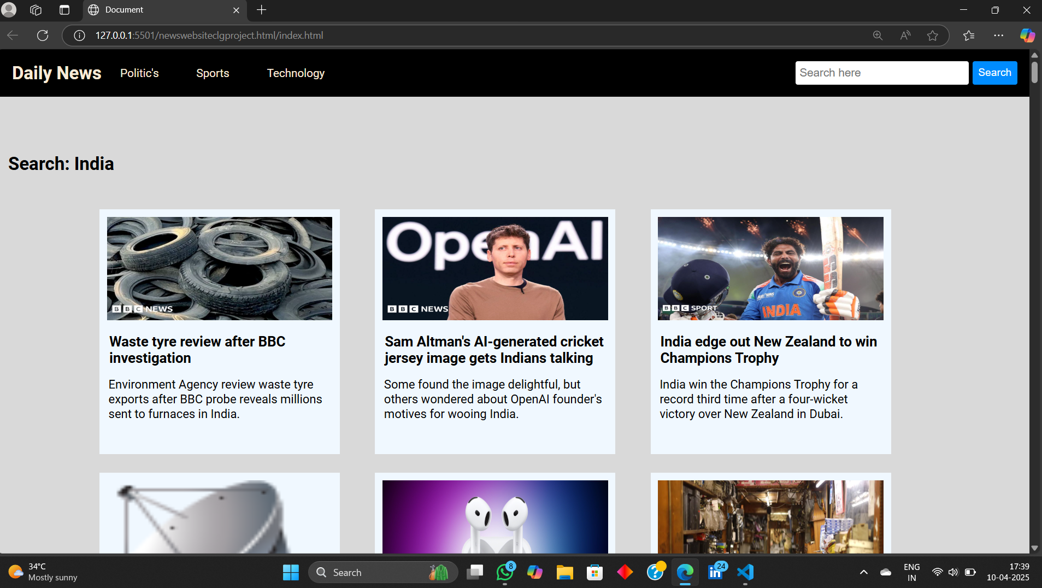
Daily News Website
“DELIVERING NEWS THAT MATTERS , FASTER THAN EVER”
Group Name: “Team Innovators”
1.Janvi kale
2.Kartiki yawatkar
3.Madhura Ingole
4.Tanvi Mahatme

Slide 2
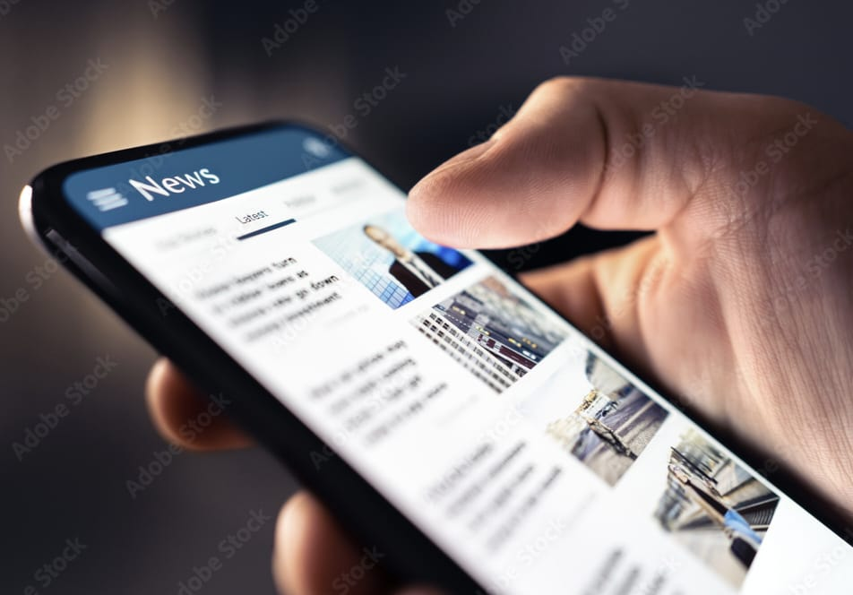
problem statement
“In today’s digital age , people need quick and easy access to the latest news. So We wanted to create a user-friendly, fast and visually clean news platform.”

Slide 3
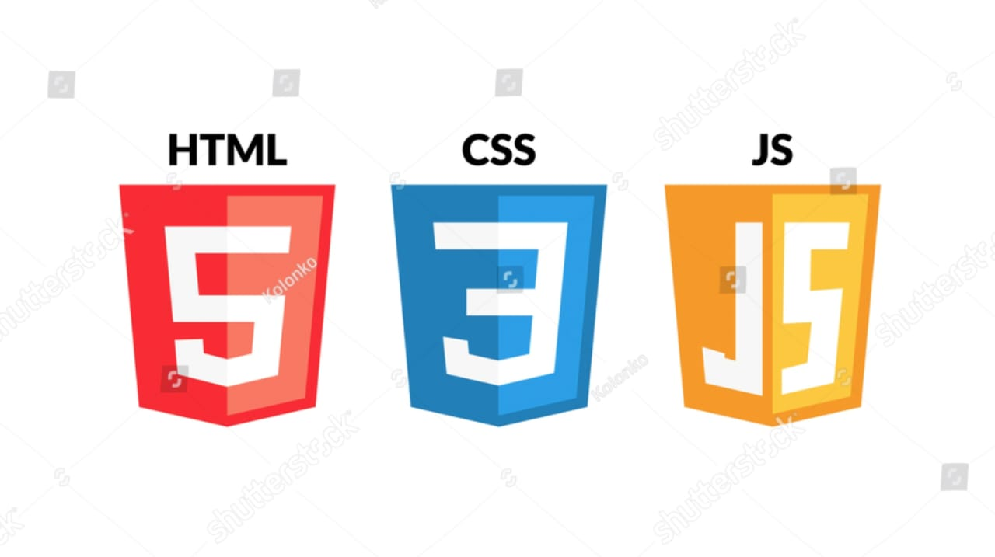
Technologies used
HTML : It is used for page structure
2. CSS : It is used for styling and layout
3. Javascript : It is used for interactivity and navigation

Slide 4
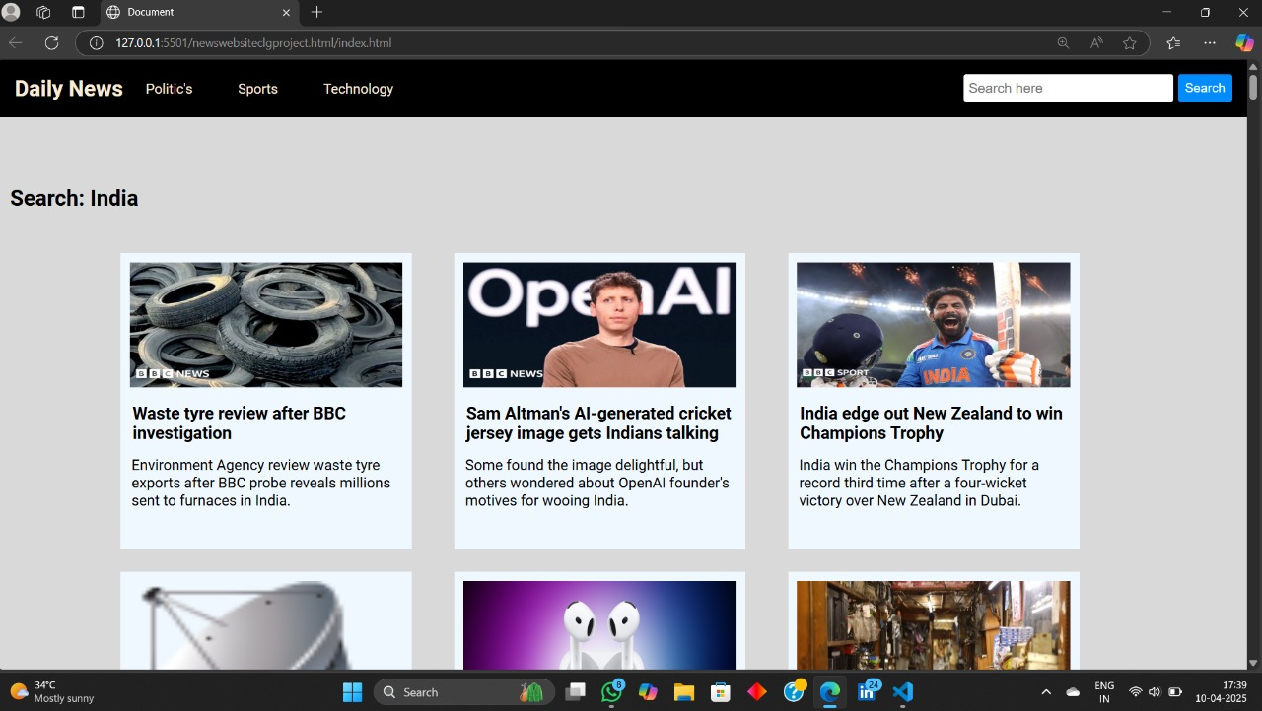
Features of website
It gives real-time updates.
There are some navigations items like politics , sports etc.

Slide 5
It is completely responsive web.
It is world wide web.
It Fetch and show the latest headline from API(Application Programming Interface).
Our website include multiple categories like technology, sports, etc.
We Design it to look great on both mobile and desktop.

Slide 6
--“Here are some screenshots of our website”
This is the homepage of our website .

Slide 7
“Conclusion”
We successfully development a responsive and functional news website .
Learned valuable front-end development and teamwork skills.
Gained practical experience in web development and API handling.
Used HTML, CSS, and JavaScript for front-end design and interactivity.

Slide 8


